Slide 1
US Oil Spill Accidents
Statistical Reference
Prabhu
Ganesh
Nimoshiga

Slide 2
This analysis takes an statistical inference approach to model the US OIL SPILL ACCIDENTS Data. Here the main goal is to define, -> Damage Cost Details -> Net Cost( Overall Records/Sample Records) -> Identifying Operator who was causing more accidents and Operational Cost
Goal

Slide 3
Below is the Github link to find all analysis Docs
https://github.com/prabhusambandam/Python_Repo/tree/master/Python_KT/Hackathon-Prabhu-Team

Slide 4
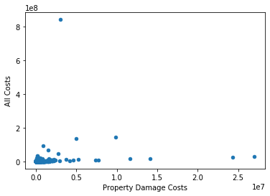

Slide 5
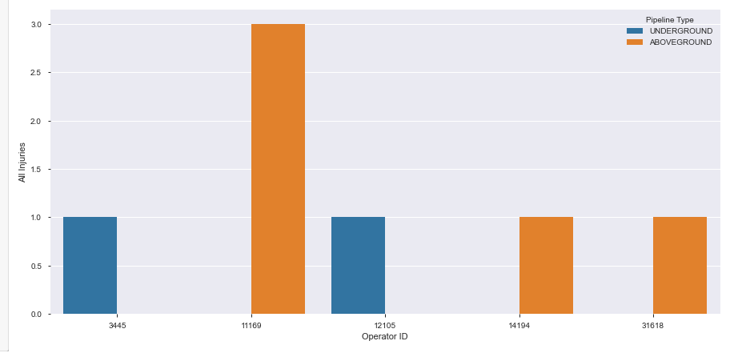
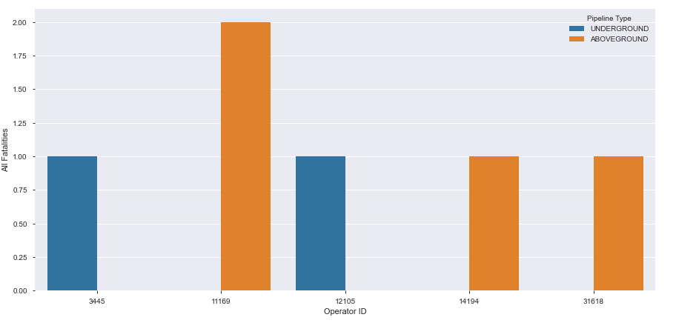

Slide 6
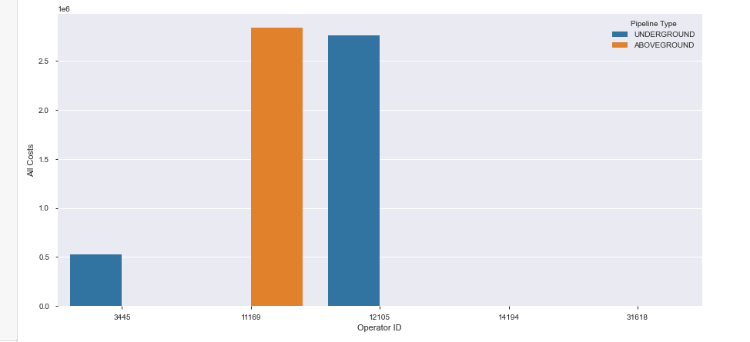

Slide 7
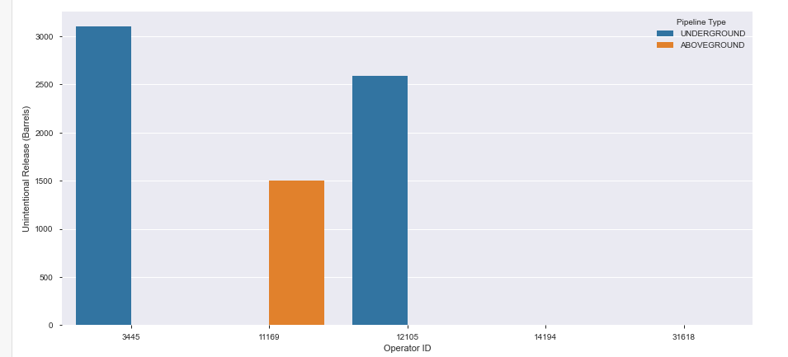

Slide 8
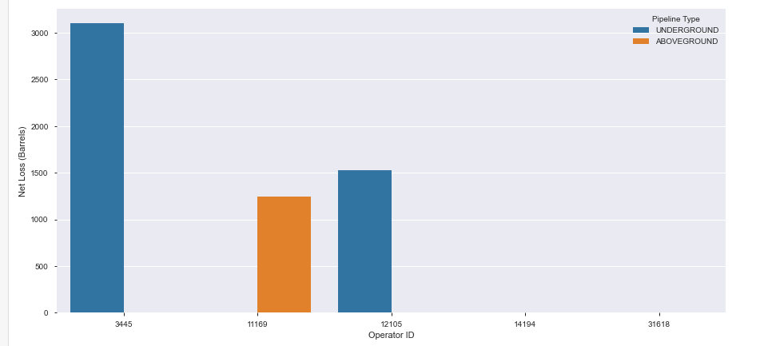

Slide 9
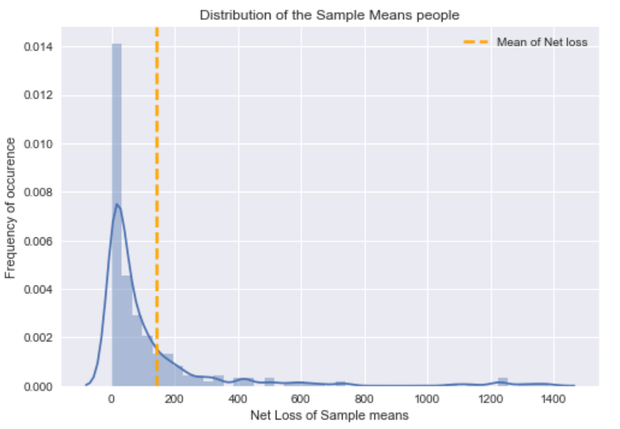

Slide 10
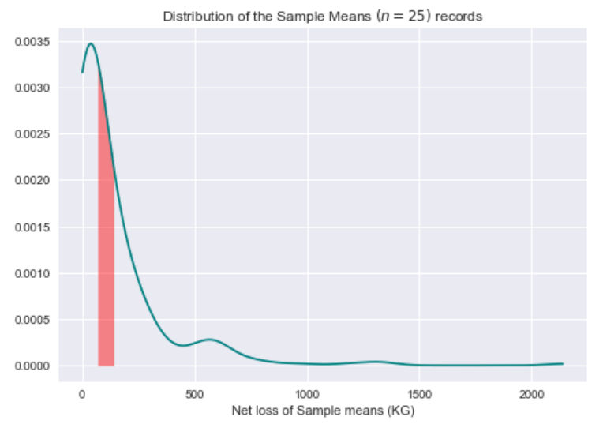

Slide 11
To Analyze:
1. Mean time of Accidents?
2. Mean time to accidents in hours? (Confidence level)
3. Time Between accidents in hours?
4. Estimation number of accidents occurs in hours/month/year?
5. Under which Category(Intentional/UnIntentional Release) major number of accidents occurs?
6. Under which SubCategory(Intentional/UnIntentional Release) major number of accidents occurs?
7. Liquid Recovery under which Category/Intentional/UnIntentional Release?
8. Which Explosion cause major Injuires Other/Public/All?
Which Explosion cause major Fatalities?
9. Shutdown Date/Time - Restart Date/Time - Ideal time?

